Slide 1
Network Hardware and its
Topologies
CSE306

Slide 2
Categories of Networks
Personal area networks
Local Area networks
Metropolitan Area networks
Wide Area networks
Wireless Networks
Home Networks
Internetworks- The Internet

Slide 3
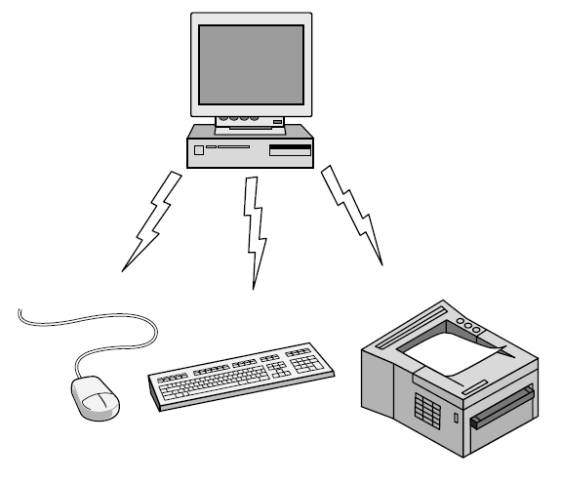
Personal Area Network
Bluetooth PAN configuration

Slide 4
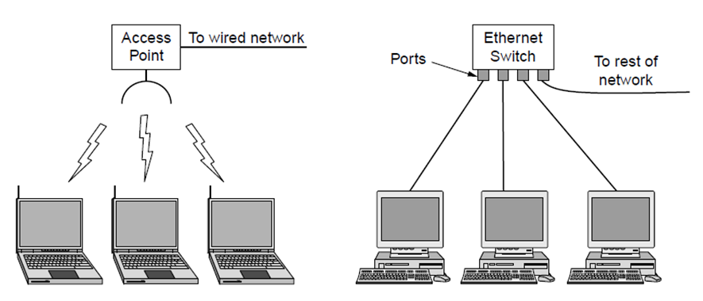
Local Area Networks (LANs)
  Short distances
  Designed to provide local interconnectivity
Wireless and wired LANs. (a) 802.11. (b) Switched Ethernet.

Slide 5

Isolated LAN connecting 12 computers to a hub in a closet
Notes:
1.#

Slide 6
Wide Area Networks (WANs)
  Long distances
  Provide connectivity over large areas

Slide 7

WANs: a switched WAN and a point-to-point WAN

Slide 8

A heterogeneous network made of four WANs and two LANs
1.<number>
Notes:
1.#

Slide 9
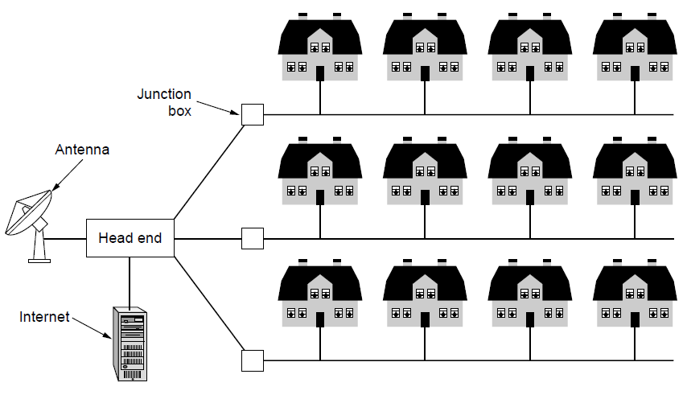
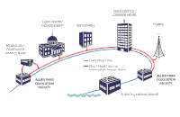
Metropolitan Area Networks (MANs)
  Provide connectivity over areas such as a city, a campus
A metropolitan area network based on cable TV or telephone cable using DSL

Slide 10
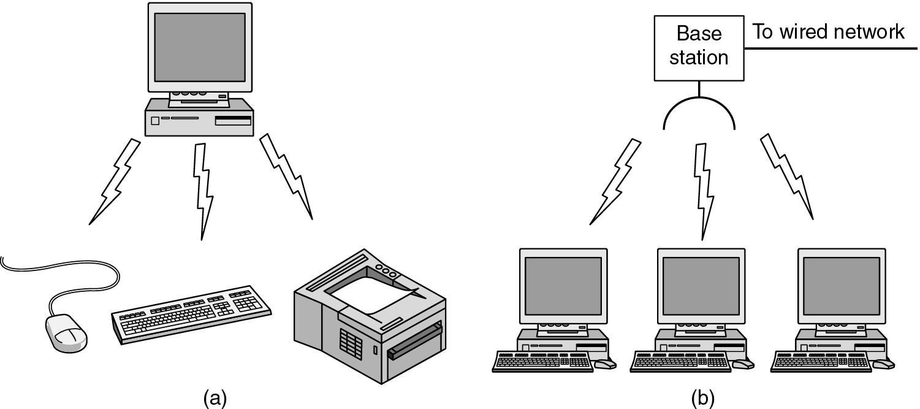
Wireless Networks
(a) Bluetooth Configuration (b) Wireless LAN

Slide 11
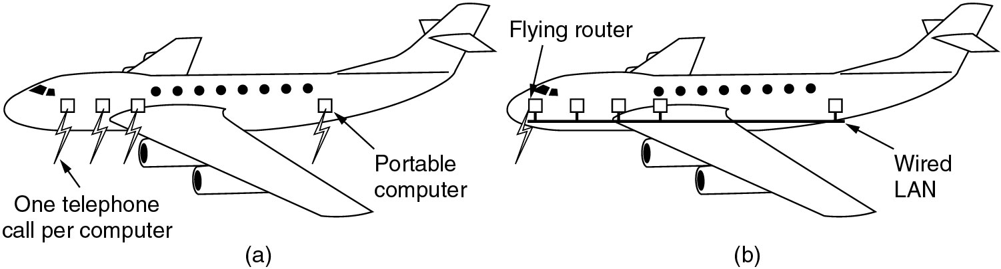
Wireless Networks
(a) Individual mobile computers
(b) A flying LAN

Slide 12
Home Network Categories
Computers (desktop PC, PDA, shared peripherals)
Entertainment (TV, DVD, VCR, camera, stereo, MP3)
Telecomm (telephone, cell phone, intercom, fax)
Appliances (microwave, fridge, clock, furnace)
Telemetry (utility meter, burglar alarm(security alarm is a system designed to detect intrusion), babycam).
Note:- VCR(Videocassette Recorder) a magnetic tape system popular in home theater systems during the 1980s and 1990s.
DVD, is Digital Video Disc or Digital Versatile Disc, type of optical disc used for data storage and as a platform for multimedia.
Furnaces heat air and distribute the heated air through the house using ducts. Boilers heat water, and provide either hot water or steam for heating.
Telemetry is the automatic measurement and wireless transmission of data from remote sources. In general, telemetry works in the following way: Sensors at the source measure either electrical data (such as voltage or current) or physical data (such as temperature or pressure).

Slide 13
THE INTERNET
Inter connection of two or more networks become an internet.
The Internet has revolutionized many aspects of our daily lives. It has affected the way we do business as well as the way we spend our leisure time.
The Internet is a communication system that has brought a wealth of information to our fingertips and organized it for our use.

Slide 14

Hierarchical organization of the Internet
NAP (Network Access Point) The point from which an Internet service provider (ISP) drops down its lines and establishes a peering arrangement to provide Internet connectivity to customers.

Slide 15
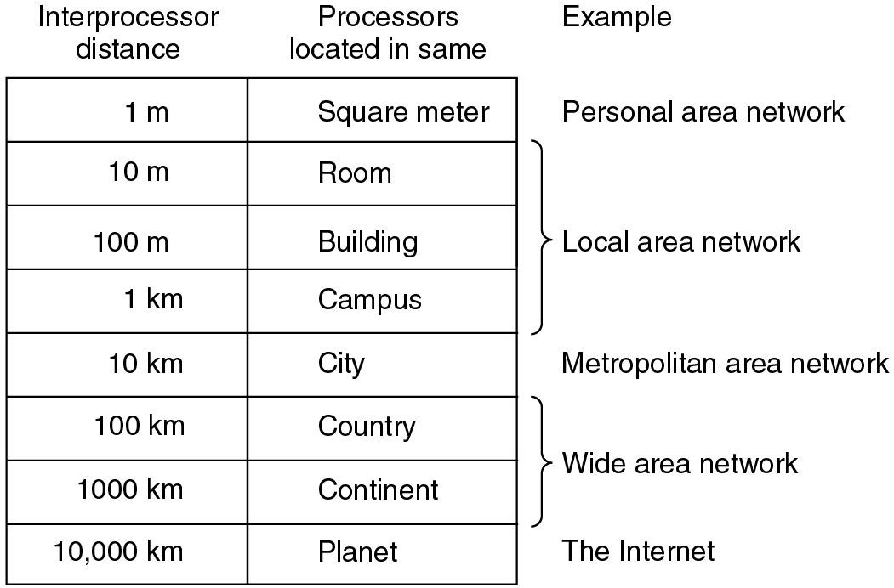
Broadcast Networks
Classification of interconnected processors by scale.

Slide 16
Network Topology
The topology of a network defines how the nodes of a network are connected.
The shape of the cabling layout used to link devices is called the physical topology of the network.
The logical topology, in contrast, is the way that the signals act on the network media, or the way that the data passes through the network from one device to the next without regard to the physical interconnection of the devices.

Slide 17
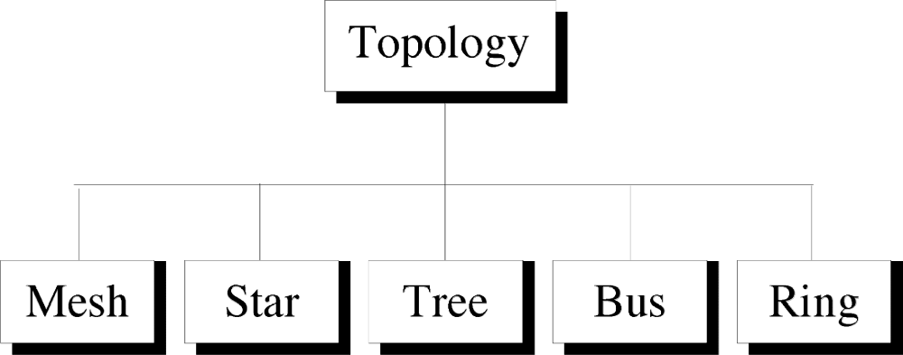
Categories of Physical Topology

Slide 18
Mesh Topology
Here every device has a point to point link to every other device.
Node 1 node must be connected with n-1 nodes.
A fully connected mesh can have n(n-1)/2 physical channels to link n devices.
It must have n-1 I/O ports.

Slide 19

A fully connected Mesh Topology (five devices)
Suppose, the N number of devices are connected with each other in a mesh topology, the total number of ports that are required by each device is N-1. In above diagram, there are 5 devices connected to each other, hence the total number of ports required by each device is 4.
Total number of ports required=N*(N-1)
1.<number>
Notes:
1.#

Slide 20
Advantages of Mesh
They use dedicated links so each link can only carry its own data load. So traffic problem can be avoided.
It is robust. If any one link get damaged it cannot affect others.
It gives privacy and security.(Message travels along a dedicated link)
Fault identification and fault isolation are easy.

Slide 21
Disadvantages of Mesh
Installation and configuration are difficult.
The amount of cabling and the number of I/O ports required are very large. Since every device is connected to each devices through dedicated links.
The sheer bulk of wiring is larger then the available space.
Hardware required to connected each device is highly expensive.

Slide 22
Applications of Mesh
Telephone Regional office.
WAN (Wide Area Network).

Slide 23
Star Topology
Here each device has a dedicated point-to-point link to the central controller called “Hub”(Act as a Exchange).
There is no direct traffic between devices.
The transmission are occurred only through the central “hub”.
When device 1 wants to send data to device 2; First sends the data to hub. Which then relays the data to the other connected device.

Slide 24

Star Topology

Slide 25
Advantages of Star Topology
Less expensive then mesh since each device is connected only to the hub.
Installation and configuration are easy.
Less cabling is need then mesh.
Robustness.(if one link fails, only that links is affected. All other links remain active)
Easy to fault identification & to remove parts.
No distruptions to the network then connecting(or) removing devices.

Slide 26
Disadvantages of Star Topology
Even it requires less cabling then mesh when compared with other topologies it still large.(Ring or bus).
Dependency(whole n/w dependent on one single point(hub). When it goes down. The whole system is dead.

Slide 27
Applications of Star Topology
Star topology used in Local Area Networks(LANs).
High speed LAN often used STAR.

Slide 28
Bus Topology
A bus topology is multipoint.
Here one long cable act as a backbone to link all the devices are connected to the backbone by drop lines and taps.
Drop line- is the connection b/w the devices and the cable.
Tap- is the splitter that cut the main link.
This allows only one device to transmit at a time.

Slide 29

Bus Topology

Slide 30
When a device sends a message, it is broadcast down on the cable in both directions. Terminators at the end of the cable prevent the signal from reflecting back to the sender.
All devices on the cable constantly monitor for messages meant to them. When a device detects a message meant for it, it reads the message from the cable and the other devices will ignore it.
Since all devices are sharing the same cable, some form of control is needed to make sure which device will transmit when, otherwise there will be a collision.

Slide 31
Advantages of Bus Topology
Ease of installation.
Less cabling.
less expensive.

Slide 32
Disadvantages of Bus Topology
Difficult reconfiguration and fault isolation.
Difficult to add new devices.
Signal reflection at top can degradation in quality.
If any fault in backbone can stops all transmission.

Slide 33
Applications of Bus Topology
Most computer motherboard.

Slide 34
Ring Topology
Here each device has a dedicated connection with two devices on either side.
The signal is passed in one direction from device to device until it reaches the destination and each device have repeater.
When one device received signals instead of intended another device, its repeater then regenerates the data and passes them along.
To add or delete a device requires changing only two connections.

Slide 35

Ring Topology

Slide 36
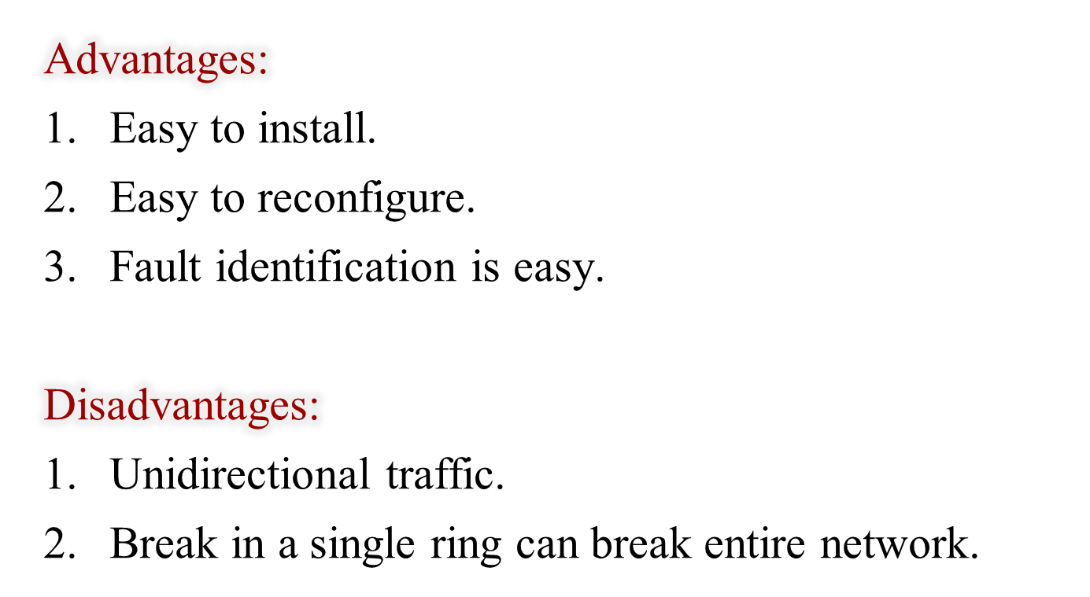
Ring Topology

Slide 37
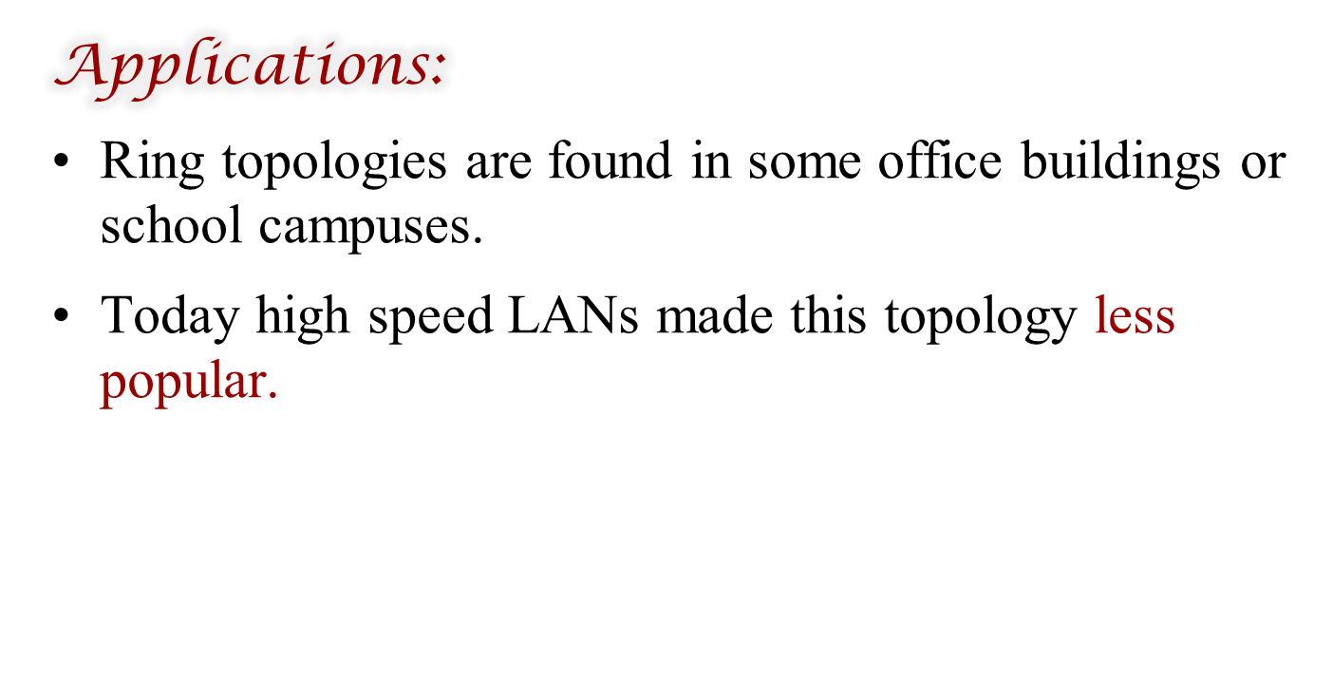
Ring Topology

Slide 38
Tree Topology
Alternatively referred to as a star bus topology.
Tree topology is one of the most common network setups that is similar to a bus topology and a star topology.
A tree topology connects multiple star networks to other star networks. Below is a visual example of a simple computer setup on a network using the star topology.

Slide 39
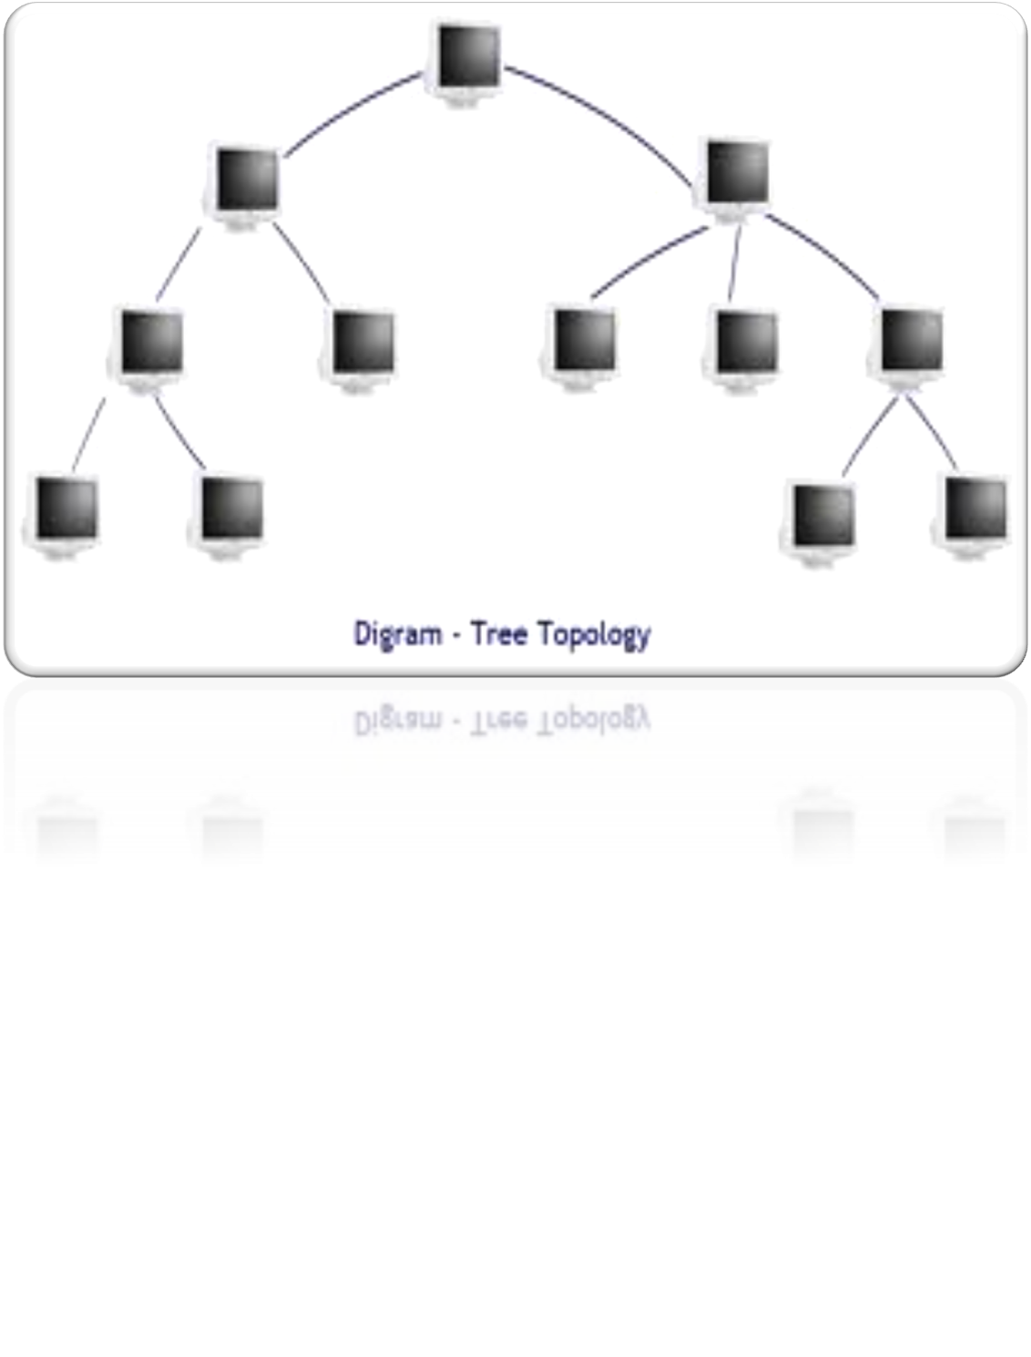

Slide 40
Hybrid Topology
A network which contain all type of physical structure and connected under a single backbone channel.

Slide 41
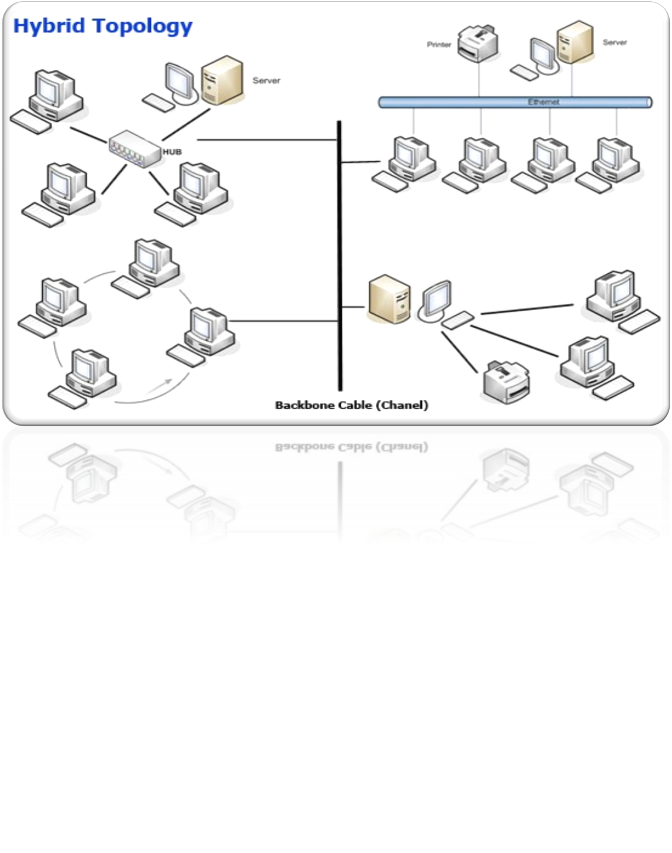

Slide 42

Hybrid Topology

Slide 43
Considerations for Choosing Network Topology
Money-Bus n/w may be the least expensive way to install a n/w.
Length-of cable needed- the linear bus n/w uses shorter lengths of cable.
Future growth-with star topology, expending a n/w is easily done by adding another devices.
Cable type-most common used cable in commercial organization is twisted pair. Which is often used with star topologies.

Slide 44
Full mesh topology is theoretically the best since every device is connected to every other device.(thus maximizing speed and security. however, it quite expensive to install)
Next best would be tree topology , which is basically a connection of star.

Slide 45
Backbone Networks: Serial Backbone
Daisy chain: linked series of devices
  Hubs and switches often connected in daisy chain to extend a network
Hubs, gateways, routers, switches, and bridges can form part of backbone
Extent to which hubs can be connected is limited

Slide 46
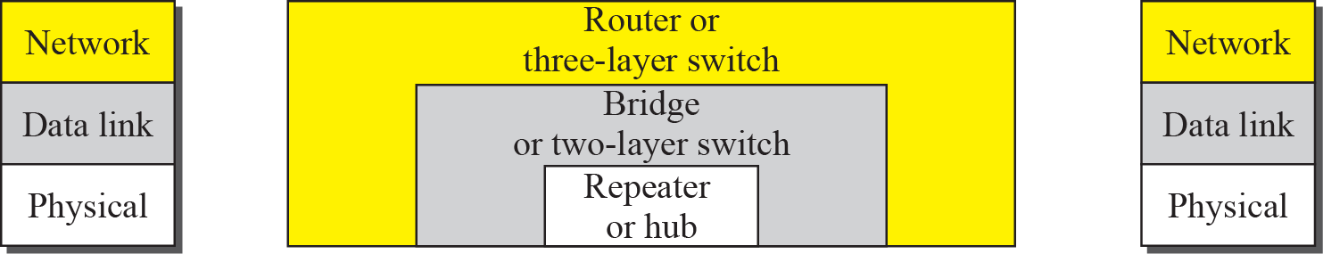
Connecting devices

Slide 47
Repeater or hub
A repeater forwards every bit; it has no filtering capability.

Slide 48
A router is a three-layer
(physical, data link, and network) device.

Slide 49
A repeater or a bridge connects segments of a LAN.
A router connects independent LANs or WANs to create an internetwork (internet).

Slide 50
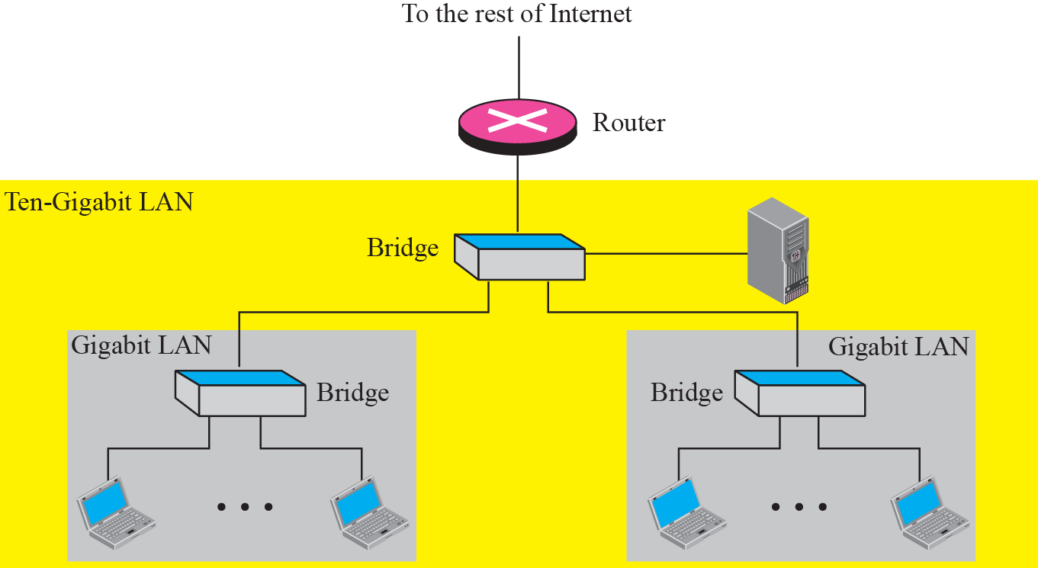
Routing example

Slide 51
Hub
Broadcast
More collision
Connect same networking device

Slide 52
Switch
Switch is intelligent device
Learning the address
Forwarding
Work on mac address

Slide 53
Router
Connect different networks
Routing

